Slide 1
Topic: “The Sufficiency of Grace: The Legacy of John R W Stott and Kwame Bediako”
Text: 2 Cor. 12: 6 -10
© Las G. Newman, PhD, JP
Anyang First Presbyterian Church, Seoul, Korea 2014

Slide 2
On behalf of the
INFEMIT NETWORKING TEAM
and
THE STOTT-BEDIAKO FORUM 2014
Thank you for your warm welcome and gracious hospitality.

Slide 3
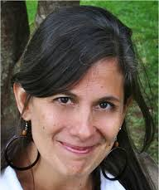
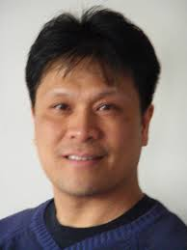
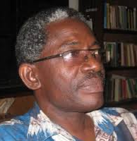
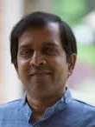
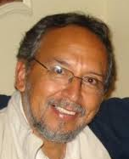
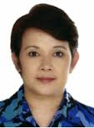
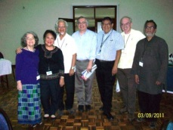
INTERNATIONAL FELLOWSHIP FOR MISSION AS TRANSFORMATION (INFEMIT) NETWORKING TEAM

Slide 4
INFEMIT NETWORKING TEAM
RUTH PADILLA DEBORST (Costa Rica/INFEMIT Latin America), Coordinator of the Networking Team
AL TIZON (USA/INFEMIT USA). Associate Professor of Holistic Ministry, Palmer Theological Seminary of Eastern University in Philadelphia, Pennsylvania, USA. He is also the co-President of Evangelicals for Social Action, USA.
WONSUK MA (UK/INFEMIT Asia). Director of the Oxford Centre for Mission Studies, David Yonggi Cho Research Tutor of Global Christianity.
LAS NEWMAN (Jamaica/INFEMIT Caribbean), President of the Caribbean Graduate School of Theology in Kingston, Jamaica.
CORNELIU CONSTANTINEANU (Romania/INFEMIT Europe) Professor of Theology, Institutul Teologic Penticostal (Pentecostal Theological Institute) in Bucharest,

Slide 5
BENHARDT QUARSHIE (Ghana/INFMIT Africa). Rector of the Akrofi-Christaller Institute of Theology, Mission and Culture in Akropong-Akuapem, Ghana, Secretary - General of the African Theological Fellowship.
PAUL JOSHUA (India/INFEMIT Asia). Professor of Theology at the South Asia Institute of Christian Studies (SAICS), Bangalore, India.
MARCELO VARGAS (Bolivia/INFEMIT Latin America). Secretary-General of the Latin American Theological Fellowship and the Director of the Centro de Capacitación Misionera (Training Center for Mission) in La Paz, Bolivia.
MUNTHER ISAAC (Bethlehem/INFEMIT Middle East & North Africa). is Vice Academic Dean at Bethlehem Bible College.
MENCHIT WONG (Philippines/INFEMIT Asia). International Director for Child Advocacy, Compassion International.
CHRIS WILSON (USA) serves as the INFEMIT Executive Assistant and Technical Support

Slide 6
We are here in Seoul to reflect on the life and legacy of two men of God who have made significant contributions to the Global Church in the 20th Century and whose life and work continue to serve as inspiration to many.

Slide 7
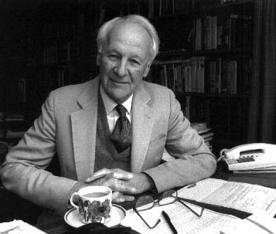
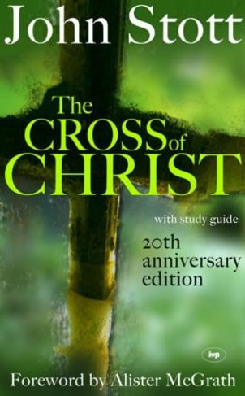
John R W Stott (1921-2011)

Slide 8
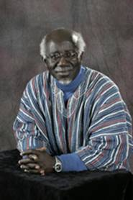
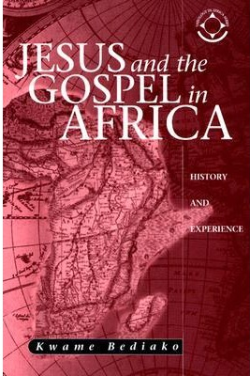
Kwame Bediako (1945-2008)

Slide 9
The Legacy of Stott-Bediako?
What is the Legacy of John R W Stott and Kwame Bediako?
It is like the legacy of St. Paul which he outlines and defends in his letter to the Church at Corinth.

Slide 10
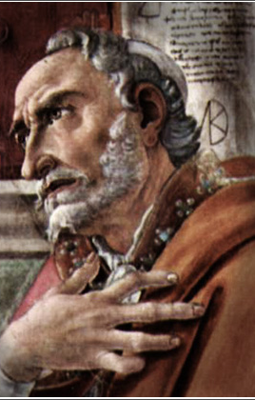
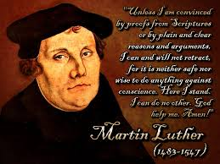
It is what he as the Apostle to the Gentiles, Augustine, the 4th century Bishop of Hippo, Luther the 16th German Reformer, John Newton, the 18th slave trader, all discovered- Grace – “Amazing Grace, how sweet the sound”.
Augustine Martin Luther john Newton

Slide 11
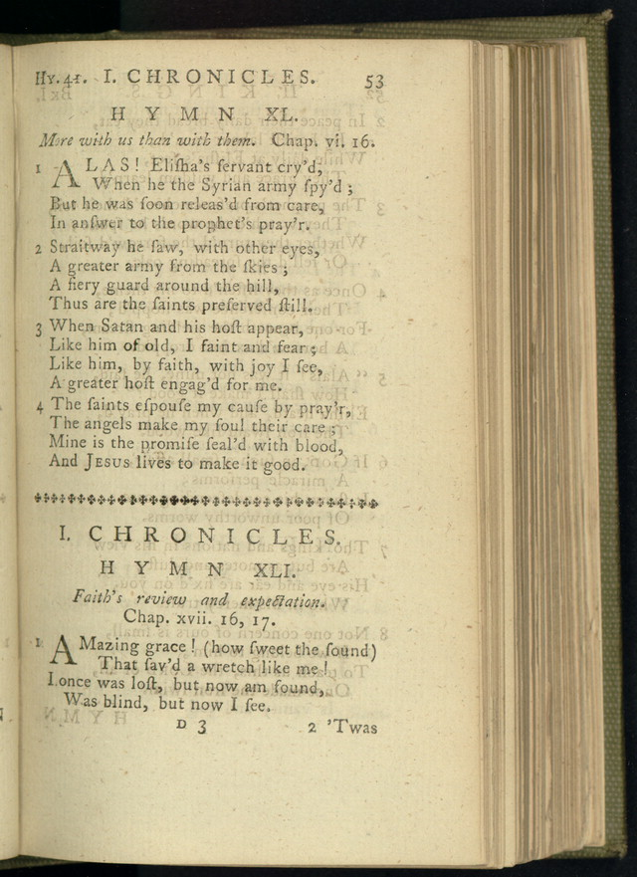
John Newton, English sailor, poet, (1725–1807), “Amazing Grace, How sweet the sound’, published in 1779.

Slide 12
Amazing grace! (how sweet the sound) That sav’d a wretch like me! I once was lost, but now am found, Was blind, but now I see.
’Twas grace that taught my heart to fear, And grace my fears reliev’d; How precious did that grace appear, The hour I first believ’d!
Thro’ many dangers, toils and snares, I have already come; ’Tis grace has brought me safe thus far, And grace will lead me home.

Slide 13
Our Text is (2 Cor. 12:6-10)
⁶ Even if I should choose to boast, I would not be a fool, because I would be speaking the truth. But I refrain, so no one will think more of me than is warranted by what I do or say, ⁷ or because of these surpassingly great revelations. Therefore, in order to keep me from becoming conceited, I was given a thorn in my flesh, a messenger of Satan, to torment me. ⁸ Three times I pleaded with the Lord to take it away from me.⁹ But he said to me, “My grace is sufficient for you, for my power is made perfect in weakness. ”Therefore I will boast all the more gladly about my weaknesses, so that Christ’s power may rest on me. ¹⁰ That is why, for Christ’s sake, I delight in weaknesses, in insults, in hardships, in persecutions, in difficulties. For when I am weak, then I am strong.”

Slide 14
What are the lessons of 2 Cor. 12?
1. PAUL’S DISCOVERY OF THE GENIUS
OF THE JUDEO - CHRISTIAN FAITH
The Paradox of Biblical Truth
“Therefore, in order to keep me from becoming conceited, I was given a thorn in my flesh, a messenger of Satan, to torment me. ⁸ Three times I pleaded with the Lord to take it away from me.⁹ But he said to me, “My grace is sufficient for you, for my power is made perfect in weakness”.

Slide 15
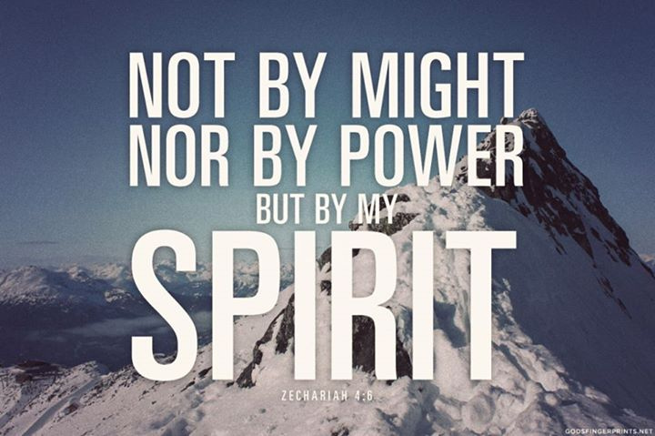
In the Old Testament, the ancient Hebrews came to learn that might is not always right. The story of David and Goliath made the point. The prophet Zechariah declared God’s way (Zech. 4:6)

Slide 16
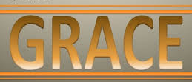
2. PAUL’S TESTIMONY OF THE WISDOM OF GOD’S GRACE
“Therefore I will boast all the more gladly about my weaknesses, so that Christ’s power may rest on me. ¹⁰ That is why, for Christ’s sake, I delight in weaknesses, in insults, in hardships, in persecutions, in difficulties. For when I am weak, then I am strong”.
(2 Cor 12: 9-10 NIV)

Slide 17
Paul’s as Pastor and Apostle
1. Paul’s Relationship with the Corinthian Church
Volatile. Tense. Adversarial. (1 cor. 1 - 4)
2. Paul’s Response to the Challenge of the Corinthian
Church
Strong. Direct. Insistent on upholding Biblical principles over cultural norms. (2 Cor. 4 - 7)
3. Paul’s Regard for the Corinthian Church
Affectionate, Discerning, Disciple-making. (2 Cor. 9 - 12)

Slide 18
What were the key concerns of John Stott and Kwame Bediako ?
THE PARADOX OF BIBLICAL TRUTH - (v. 9 -10)“when I am weak, then I am strong”
THE IMPORTANCE OF BIBLICAL HUMILITY – (v.6,7) pride, arrogance, competitiveness, simplicity of lifestyle.
A PLEA FOR EVANGELICAL UNITY – “religion is hard when you believe you have the truth and no one else has it”.

Slide 19
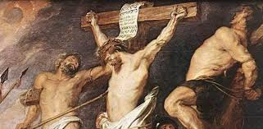
First Legacy
1. The Paradox of Biblical Truth
(2 Cor.12: 9-10)“ when I am weak, then I am strong”

Slide 20
John Stott writes:
“The only God I believe in is the One Nietzsche ridiculed as 'God on the cross.' In the real world of pain, how could one worship a God who was immune to it? I have entered many Buddhist temples in different Asian countries and stood respectfully before the statue of the Buddha, his legs crossed, arms folded, eyes closed, the ghost of a smile playing round his mouth, a remote look on his face, detached from the agonies of the world.

Slide 21
But each time after a while I have had to turn away. And in imagination I have turned instead to that lonely, twisted, tortured figure on the cross, nails through hands and feet, back lacerated, limbs wrenched, brow bleeding from thorn-pricks, mouth dry and intolerably thirsty, plunged in Godforsaken darkness. That is the God for me! He laid aside his immunity to pain. He entered our world of flesh and blood, tears and death. He suffered for us. Our sufferings become more manageable in the light of his:
“The Cross of Christ”

Slide 22
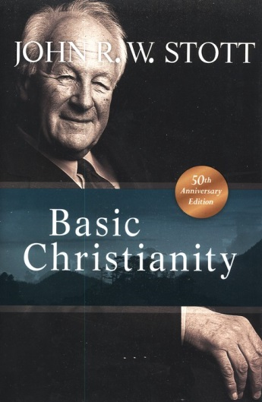
“The astonishing paradox of Christ's teaching and of Christian experience is this: if we lose ourselves in following Christ, we actually find ourselves. True self-denial is self-discovery. To live for ourselves is insanity and suicide; to live for God and for man is wisdom and life indeed. We do not begin to find ourselves until we have become willing to lose ourselves in the service of Christ and of our fellows.”
“Basic Christianity”

Slide 23
Manasseh Kwame Dakwa Bediako, late rector of the Akrofi-Christaller Institute for Theology, Mission, and Culture,[1] in Akropong, Ghana, was born on July 7, 1945. He died, following a serious illness, on June 10, 2008. Over many years he pointed others to Africa's proper place in contemporary worldwide Christian discourse.
Andrew F. Walls

Slide 24
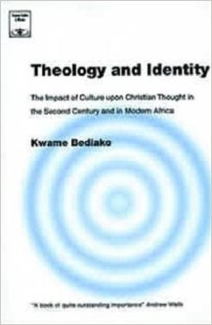
He charted new directions for African Christian theology. He labored so that generations of scholars, confident equally of their Christian and their African identity, might be formed in Africa, and to that end he created a new type of institution where devotion to scholarship and understanding of the cultures of Africa would be pursued in a setting of Christian worship, discipleship, and mission.
Andrew F. Walls

Slide 25
But his immediate call was to Ghana and to the pastorate of the Ridge Church in Accra. In colonial times Ridge Church had been the church of the expatriate officials; by this time it had a burgeoning and very diverse congregation, where Anglicans, Methodists, and Presbyterians in rotation provided the resident pastor. The three years (1984-87) that Kwame spent there were formative for him in what they revealed of the concerns, aspirations, and anxieties of African Christians, and in later years he was never less of a pastor for being a scholar and academic. Indeed, even before he left Aberdeen he had a clear vision of what his ongoing work was to be, and pastoral concerns were at its heart.
Andrew F. Walls

Slide 26
The Legacy of Kwame Bediako

Slide 27
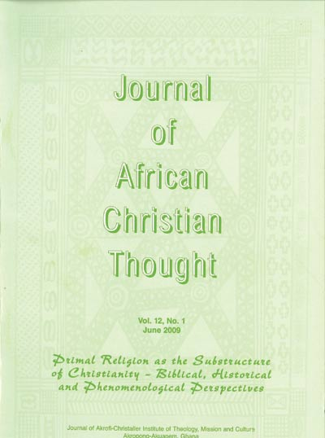
Kwame Bediako taught us that as the center of gravity of Global Christianity has shifted from the Global North to the Global South, Christians in Africa and throughout the Global South must appropriate the Gospel of Christ within their own culture as a demonstration of God’s marvelous grace.

Slide 28
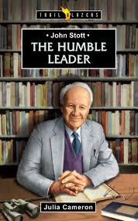
Second Legacy
2. The Importance of Biblical Humility Pride, Arrogance, competitiveness, simplicity of lifestyle

Slide 29
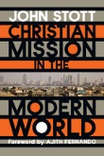
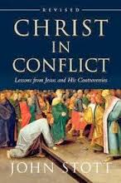
I do not know what “thorn in the flesh” John Stott and Kwame Bediako had in their life. But I do know that in their life and ministry they encountered conflict, tension, and stress in a variety of ways.
They worked through these situations with reliance on God’s powerful and amazing Grace.

Slide 30
“The very first thing which needs to be said about Christian ministers of all kinds is that they are "under" people as their servants rather than "over" them (as their leaders, let alone their lords). Jesus made this absolutely plain. The chief characteristic of Christian leaders, he insisted, is humility not authority, and gentleness not power”.

Slide 31
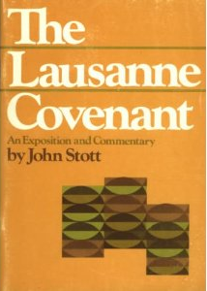
John Stott played a key role in the framing of the historic Lausanne Covenant, 1974

Slide 32
Evangelism and Mission: The Central Task of the Church

Slide 33
In humility, he acknowledged the understanding of Christian Mission from the Global South as what we now call, Integral Mission. Article 5 of the covenant says:
5. CHRISTIAN SOCIAL RESPONSIBILITY We affirm that God is both the Creator and the Judge of all men. We therefore should share his concern for justice and reconciliation throughout human society and for the liberation of men and women from every kind of oppression. Because men and women are made in the image of God, every person, regardless of race, religion, colour, culture, class, sex or age, has an intrinsic dignity because of which he or she should be respected and served, not exploited. Here too we express penitence both for our neglect and for having sometimes regarded evangelism and social concern as mutually exclusive.

Slide 34
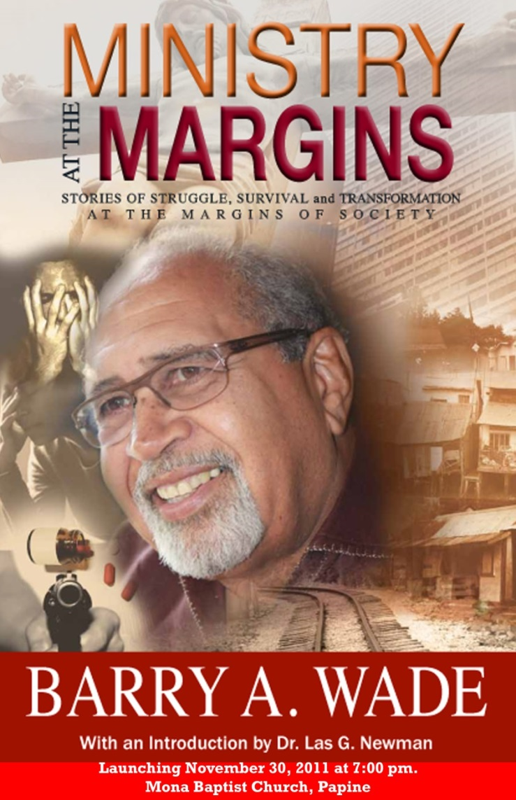
The philosophy of INTEGRAL MISSION and
MISSION as TRANSFORMATION
is what drives the INFEMIT team.

Slide 35
Call to Humility
The call to humility is a call to recognize that but for the Grace of God we would not be where we are.
We would be without redemption and without hope in the world.
St. Paul was given a ‘thorn in the flesh’ to teach and remind him in humility that God’s grace is sufficient to meet any situation in life.

Slide 36
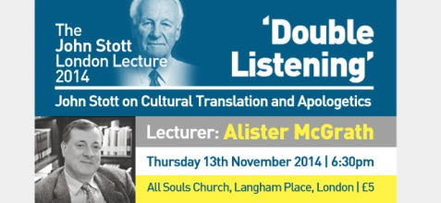
The Call to Humility is a Call to “Double Listening”
Listening to the WORD Listening to the WORLD

Slide 37
Third Legacy
3. A Plea for Evangelical Unity
Paul, writing to the Church at Ephesus says:
“Be completely humble and gentle; be patient, bearing with one another in love. Make every effort to keep the unity of the Spirit through the bond of peace”.
Ephesians 4: 2-3 NIV

Slide 38
The Struggle for Christian Unity
John Stott and Kwame Bediako worked tirelessly to bring the church together, especially the evangelical community.
They collaborated with many churches and organizations to foster unity in Christ and unity in mission.
They were discouraged at times by the disunity in the church and lack of cooperation.

Slide 39
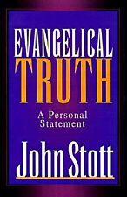
“I have at least two conscious motives," in writing this book to an international audience. [p. 11].
"First, I continue to be profoundly grieved by our evangelical tendency to fragment.

Slide 40
During the last half-century the evangelical movement worldwide has grown out of all recognition in numbers, church life, scholarship, and leadership - but not, I think, in cohesion. Nowadays people refer to the multiple "tribes" of evangelicalism, and like to place a qualifying adjective in front of evangelical... conservative, liberal, radical, progressive, open, Reformed, charismatic, postmodern, and so on.

Slide 41
But is this really necessary? While holding with a good conscience whatever our particular evangelical faith may be, is it not possible for us to acknowledge that what unites us as evangelical people is much greater than what divides us?" [p. 12].

Slide 42
"Second and more personal, as I approach the end of my life on earth and as I complete more than sixty years of privileged Christian discipleship , I would like to leave behind me, as a kind of spiritual legacy this little statement of evangelical faith...This is how I would wish to be remembered and judged, as I prepare to stand before the judgment seat of Christ." [p.12]

Slide 43
Conclusion
1. Paul, the Apostle of Christ to the non-Jewish world, learned an important lesson in life. “God’s Grace is sufficient for all situations”
(2Cor.12:9).
2. This lesson has been learned by Christians in Mission and Ministry down through the ages.
3. John Stott and Kwame Bediako learned this lesson in their life and ministry and testified to it.

Slide 44
4. The legacy from the life and ministry of John Stott and Kwame Bediako is that by God’s Grace and Mercy, the church in the North and South, East and West should:
(a) grasp the profound paradox of biblical truth – ‘in Christ, there is
strength in weakness’
(b) walk in biblical humility – ‘three times I asked the Lord….”

Slide 45
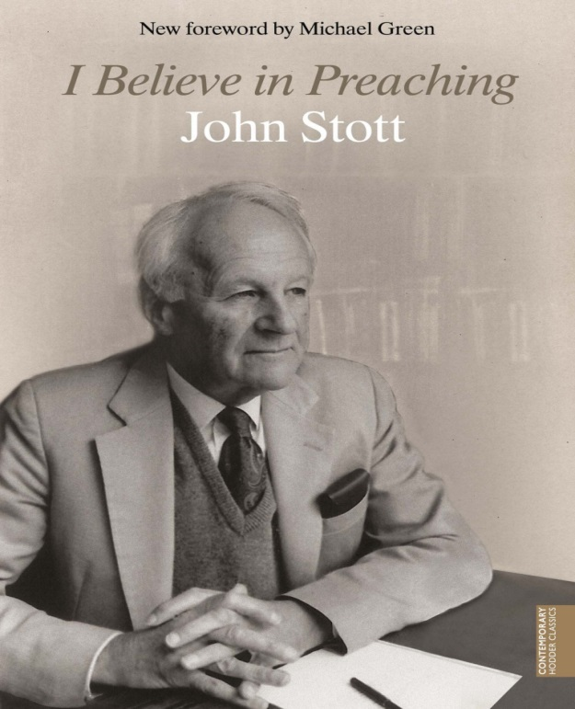
and (3) practice unity – ‘work hard to preserve the unity of the spirit in bond of peace’

Slide 46
This is the commitment of the INFEMIT Movement, in the name of our risen and ascended Lord, Jesus Christ.
AMEN

